Slide 1
Guidance of the code for scar generation
Lei Wang, Peter Marinov
19/2/2020

Slide 2
Code introduction
This C++ code can generate scar and border zone for a given mesh.
An example is included for demonstration. This is through a matlab script calling the above code.
The guidance for this example is followed.

Slide 3
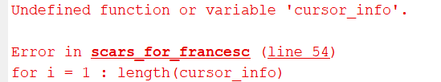
Example guidance
Compile the C++ code in Matlab: run ‘mex dijkstra2.cpp –largeArrayDims’ in matlab
Running ‘scars_for_francesc.m’ will plot the geometry from ‘bivHeart.geo’ and give the following error
Now generate ‘cursor_info’: holding Alt and select points on the figure; after selection, right click and ‘Export Cursor Data to Workspace’
Rerun ‘scars_for_francesc.m’ to obtain results, i.e. heart geometry with scar and border zone

Slide 4
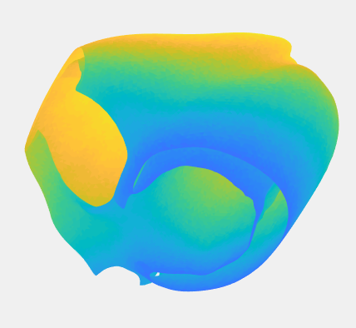
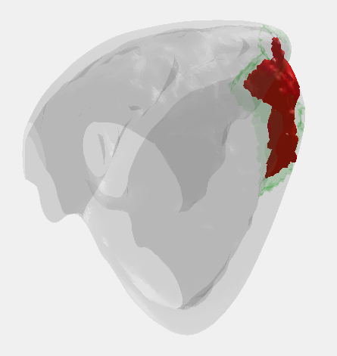
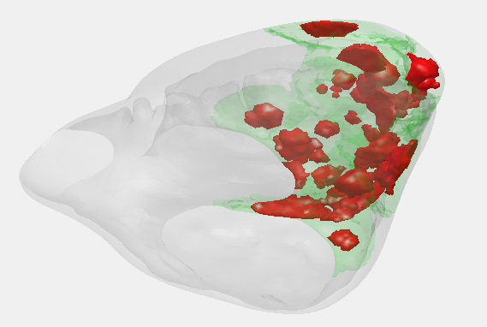
Input and output
Input: the input file ‘bivHeart.geo’ includes two sections: ‘ELEMENTS’ and ‘COORDINATES’
Output
(a) Heart visualization in matlab for selecting points
(b) Single scar
(c) Mulitiple scars

